Slide 1
IOTA Community Logo
IOTA
The distributed communication layer of tomorrow

Slide 2


DISCLAIMER:
NO FINANCIAL ADVICE WILL BE GIVEN IN THIS PRESENTATION

Slide 3
Index
whoami/whoarewe
IOTA Libraries
The IOTA Foundation
Use Cases
What today is about

Slide 4
Index
whoami/whoarewe
IOTA Libraries
The IOTA Foundation
Use Cases
What today is about

Slide 5


whoami/whoarewe
Name Surname
Your Title - yourwebsite.com
Following distributed ledger technology since 2011
Love free and open source software
Project with local company
Notes:
Present the organizers, speakers, supporters
Examples:
Your title, your line of work
what you do
when you started following IOTA

Slide 6
whoami/whoarewe
Name Surname
Your Title - yourwebsite.com
Following distributed ledger technology since 2011
Love free and open source software
Project with local company
Notes:
Present the organizers, speakers, supporters
Examples:
Your title, your line of work
what you do
when you started following IOTA

Slide 7
whoami/whoarewe
Name Surname
Your Title - yourwebsite.com
Following distributed ledger technology since 2011
Love free and open source software
Project with local company
Notes:
Present the organizers, speakers, supporters
Examples:
Your title, your line of work
what you do
when you started following IOTA

Slide 8




Technology
Governance
Ecosystem
Notes:
Important Puzzle Pieces
The Tangle and IOTA technology
The Governance by the IOTA Foundation
The Ecosystem around IOTA

Slide 9

The Tangle
The unique data structure being utilized in IOTA
Directed Acyclic Graph (DAG)
Scalable distributed framework for transactions
Transactions can hold data, value or both
Consensus
Notes:
DAG - The references among transactions form a type of directed acyclic graph (DAG), which is a sequence of vertices where every edge is directed from an earlier point to a later one in the sequence (the animation shows the three dimensional version)
Scalability - When a node attaches a new transaction to the Tangle, that transaction directly references two existing ones (make a simple multiplication to show how numbers grow)
Consensus - Network nodes are responsible for validating transactions and their histories to make sure that they don't conflict.
When a node has a transaction's entire history, the transaction is considered solid, which means that it can be considered for confirmation.
Resources for the speaker:
https://docs.iota.org/docs/dev-essentials/0.1/concepts/the-tangle

Slide 10

The Tangle
The Tangle is the immutable data structure that contains a history of IOTA transactions that IOTA libraries connect to.
Notes:
The Tangle is the immutable data structure that contains a history of IOTA transactions. All nodes in an IOTA network store a copy of the Tangle in their ledgers and can read from it and attach new transactions to it.
This removes completely the need to pay fees to miners and thus opens up the possibility to execute microtransactions which could be worth as little as a few cents.
Besides, IOTA’s DAG data structure allows for the network’s easy scalability. Everyone is participating in reaching a consensus and, therefore, the more people are using IOTA, the faster the network becomes.

Slide 11
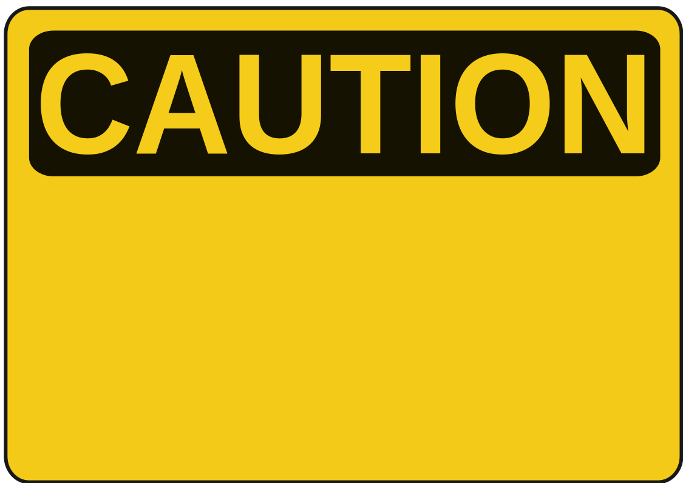
The IOTA Libraries
The IOTA client libraries abstract the complexity of the IOTA protocol into simple methods that allow you to create, send, receive, and request transactions.
Beta software
Notes:
The client libraries are currently in beta and you should not use them in production environments.

Slide 12

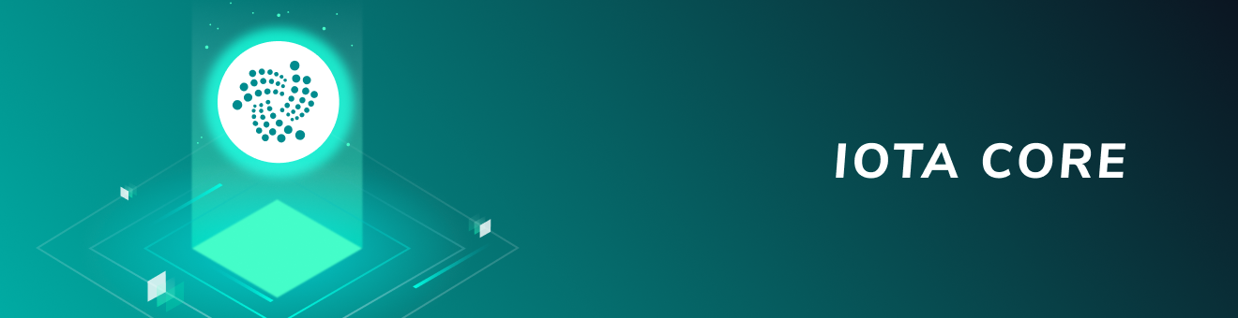
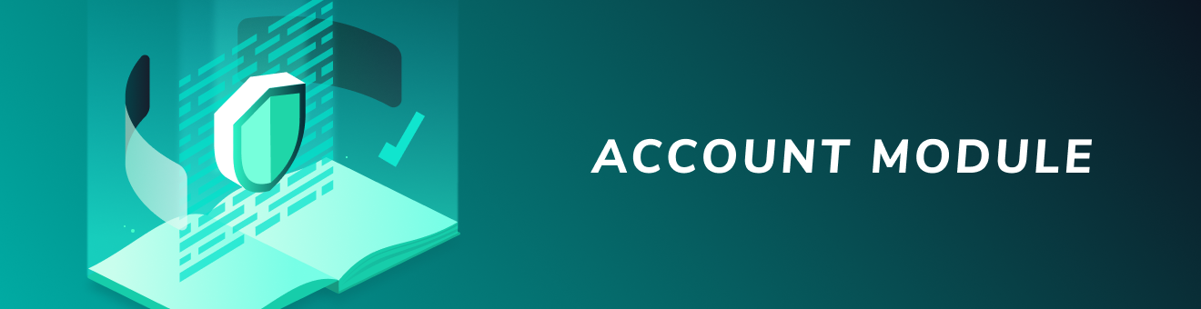

JavaScript client library
https://github.com/iotaledger/iota.js
Node.js 10 or higher
Node.js 8
Notes:
IOTA Core client library includes low-level methods for interacting with the Tangle. You can use this library to use the core IOTA protocol. For example, you can connect to nodes, create bundles, and promote and reattach pending transactions.
Account Module an account is an object that makes it easier to send and receive transactions. Accounts store data such as addresses and pending bundle hashes in a local database. This data allows you to interact with an IOTA network without worrying about withdrawing from spent addresses or promoting and reattaching pending transactions.
MAM Masked Authenticated Messaging is a data communication protocol that allows you to publish and fetch messages in encrypted data streams, called channels, on the Tangle. You can use the MAM package to publish encrypted and authenticated messages to channels. The Tangle allows you to attach zero-value transactions to it, but these transactions are not signed or checked by nodes to verify their authenticity.
Node.js: Recommended version is latest LTS.

Slide 13
Java client library
https://github.com/iotaledger/iota-java
Java 6 (or higher)

Slide 14
Golang client library
https://github.com/iotaledger/iota.go
recommend use of vgo modules (since Go 1.11)

Slide 15
Python client library
https://github.com/iotaledger/iota.py
PyOTA is compatible with Python 3.7, 3.6, 3.5 and 2.7

Slide 16
C/C++ client library
https://github.com/iotaledger/entangled

Slide 17

C# client library
https://github.com/iota-community/tangle-.net
.NET 4.6.1
.NET Standard 2.0

Slide 18
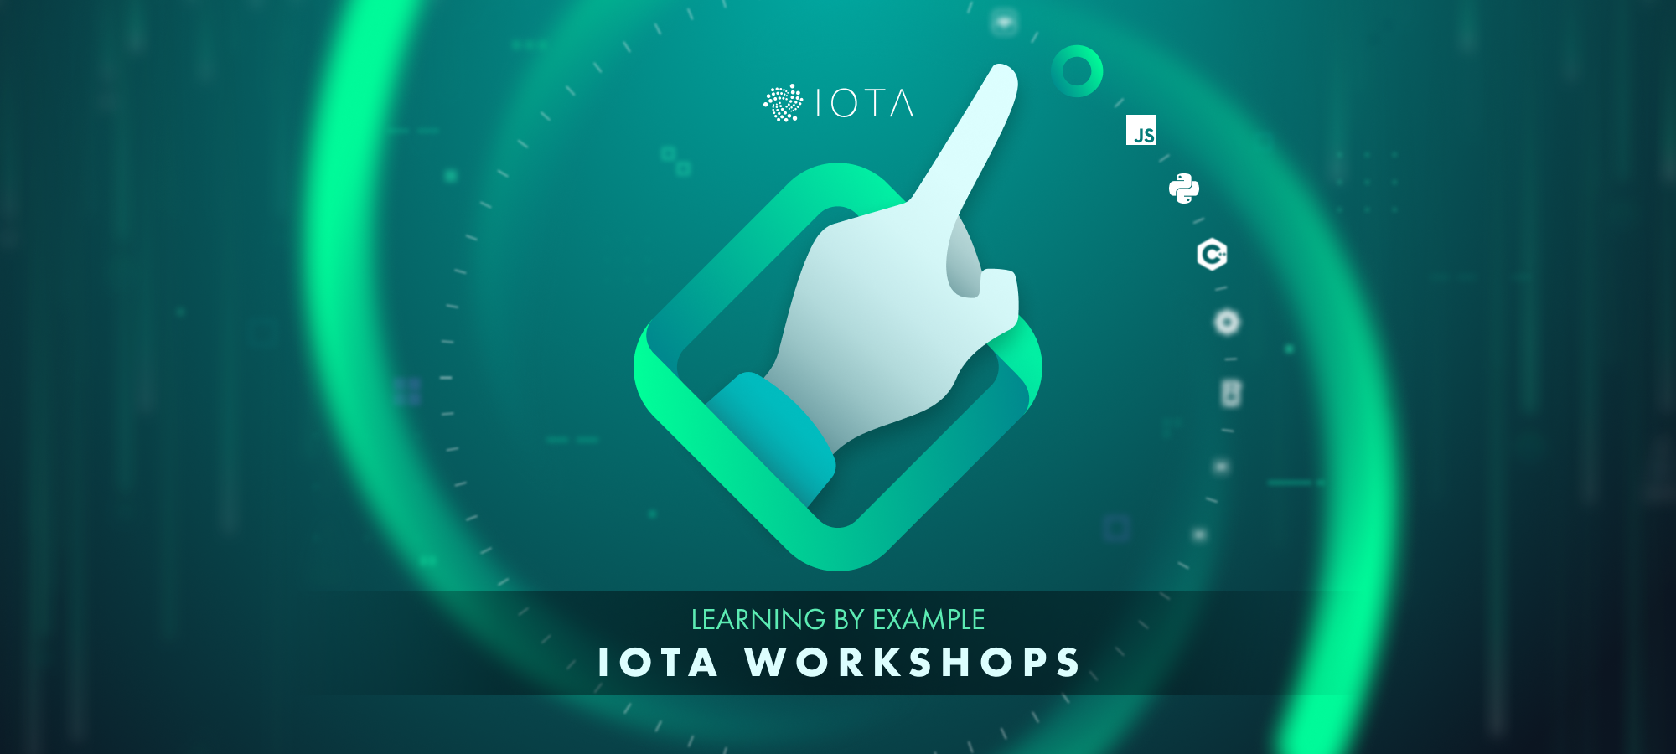

Slide 19

JavaScript Workshop
Send and receive transactions
Check your balance
Generate new addresses
Send IOTA tokens
Send and receive multi-transaction messages
Monitor a real-time stream of incoming transactions, using ZeroMQ
Send and receive data using MAM0 streams.
Notes:
The JavaScript workshop was the first workshop created — and with a good reason: JavaScript/Typescript is very often used in the IOTA Ecosystem, including the Trinity Wallet software and a lot of the proof of concepts built by the IOTA Foundation and IOTA communities.
JavaScript/TypeScript can be used in browsers (clientside) or servers in combination with Node.js (serverside), which makes it very versatile when integrating IOTA in a web-application.
The iota.js client library is a client library maintained by the IOTA Foundation and written in TypeScript. It will most likely be your best bet when you want to develop something with JavaScript and IOTA.

Slide 20

Golang Workshop
Send and receive transactions
Check your balance
Generate new addresses
Send IOTA tokens
Send and receive multi-transaction messages
Utilize a real-time stream of incoming transactions using ZeroMQ
Notes:
Go is a good compromise between the development of a higher-level language and the performance of a lower level one. The Go Client Library for IOTA offers all the basic functionality you need to interact with the Tangle using Go. This library is actively maintained by the IOTA Foundation and is extensively used in the GoShimmer prototype for Coordicide.

Slide 21
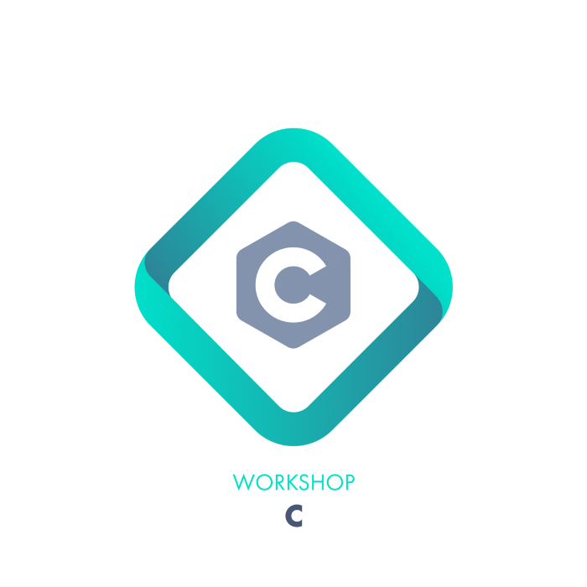
C Workshop
Send and receive transactions
Check your balance
Generate new addresses
Send IOTA tokens
Notes:
The client library for the C programming language is called “Entangled” and is one of the harder libraries to work with. That’s because it has been written in a low-level programming language.
Low-level programming languages are great for performance. They are good for devices with limited processing power/memory. However, you have to do a lot more yourself when it comes to programming — memory management, for example — which makes it harder to work with over higher-level languages, like Python or JavaScript.
The Entangled client library, built from the ground up by the IOTA Entangled team, can do a lot of things in a lot of different ways. It’s an excellent candidate for a workshop!

Slide 22

Python Workshop
Send and receive transactions
Check your balance
Generate new addresses
Send IOTA tokens
Send and receive multi-transaction messages
Utilize a real-time stream of incoming transactions using ZeroMQ
Notes:
Python is a popular higher-level programming language used for a lot of different purposes, including web development, automation, and data science. It’s easy to learn and work with, and it’s often recommended as a good first programming language to learn. A client library — called PyOTA — is available for IOTA. It covers all the basic functionalities you need to interact with the Tangle.

Slide 23
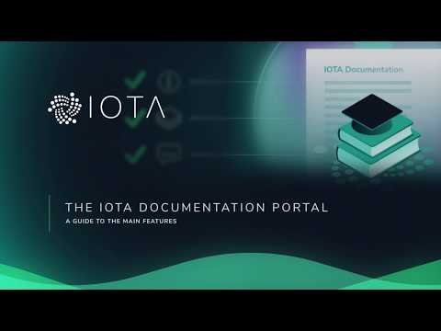
https://youtu.be/mZSG93W1u7A
Notes:
All these resources are available in the IOTA Documentation portal
https://docs.iota.org

Slide 24






Use-Cases
Telecom
Mobility
Digital Economy
- Payments
- Settlement
- Data Sharing
- Data Integrity
- Identity Management
- Smart Charging
- Over-the-Air Updates
- Car ID & Wallet
- Cars as Autonomous
Economic Agents
- Usage Based Insurance
- Car Paying for Parking
- M2M Economy
- MyData & GDPR
- Biometric Authentication
& Digital ID
- IOTA Data Marketplace
- Smart Factory
- Digital Twin
Smart City
Supply Chain
Social Impact
- Digital ID
- Smart Energy Districts
- P2P Energy Grid
- Cross vertical
- Biometric Identification
- CityxChange Smart
Cities
- Asset Tracking
- Connected Supply Chains
- Global Trade Document Flow
- Product Authenticity and
Provenance
- Ports Management
- New Insurance Models
- Digital ID & Citizen Services
- Humanitarian ID
- Real-time Environmental
Monitoring
- Financial Inclusion
Notes:
Resources for speaker:
https://files.iota.org/comms/IOTA_Use_Cases.pdf

Slide 25

The IOTA Foundation
The IOTA Foundation - to research, develop and grow market adoption of DLT
Non-profit Foundation based and regulated in Berlin, Germany
Growth from 6 to 100+ full time employees distributed across 27 countries
Focused on technical and regulatory challenges of crypto-currencies & DLT
Notes:
Make sure to emphasize that IF's goal is to be irrelevant in 5 years. One of many actors guiding, building, using the Tangle

Slide 26

IOTA Foundation - Vision & Goals

Slide 27

IOTA Ecosystem
Our universe relies on a network of many collaborators
– corporates, academics, governments, NGOs
Notes:
Sources for official Ecosystem
https://blog.iota.org
https://ecosystem.iota.org
Sources for unofficial Ecosystem:
https://iota-archive.com/

Slide 28

IOTA Ecosystem
Meet the IOTA Ecosystem
Tutorials
Projects
Events
Developers
Notes:
The IOTA Ecosystem is a hub of education, innovation, tools, collaboration and development for the IOTA distributed ledger protocol and is lead by the IOTA Foundation.
The Ecosystem also is responsible for the Ecosystem Development Fund.
Resources for speaker:
https://ecosystem.iota.org

Slide 29

IOTA Ecosystem Development Fund
Funding for projects in the IOTA Ecosystem
Proof of concepts
Open source utilities and libraries
Educational resources
Media
Philanthropic endeavors
Hackathons
Ideation workshops
Meetups
Notes:
Ecosystem Development Fund Is a collection of donations that are granted to IOTA related projects
Is committed to Transparency, accountability and by memorializing EDF funding agreements with ‘Proof-of-Existence’ transactions on the Tangle, anyone will be able to verify that agreements the EDF enters existed in a certain state at a certain point in time. The IOTA community can thus hold both the EDF and the benefactors of EDF
Resources for speaker:
https://fund.iota.org

Slide 30

Coordicide Grant Program
Research Grant
e.g.
Optimization of the networking layer to avoid network congestion
Reputation system based on node behavior
Theoretical behavior of cellular automata based consensus
Theoretical properties of query-based voting schemes (e.g., FPC)
https://coordicide.iota.org/grants
Notes:
This project is IOTA’s top priority, and there is the possibility to collaborate through the Coordicide grant program, which offers both large and small grants for research on any aspect of Coordicide.

Slide 31


Mobility & Automotive - PoC by bIOTAsphere
Insuremycar PoC
Dynamic insurance provider
Direct payments
Vehicle monitoring
Proof-of-Concept
NOT endorsed by Tesla
Notes:
Resources for speaker:
https://youtu.be/6VYQYlzNPFs

Slide 32


IIoT/IoT - Bosch XDK
Fast and easy IOTA integration for prototypes
Secure and immutable sensor data transmission via IOTA
Micropayments on data marketplaces
Bosch XDK110 and
Masked Authentication Messaging
Notes:
Resources for the speaker:
XDK2MAM: https://xdk2mam.io
Data marketplace open source blueprint: https://docs.iota.org/docs/blueprints/0.1/data-marketplace/overview
Industry Marketplacehttps://industry.iota.org/

Slide 33
Contacts:
Sponsors:
Get involved:
email@provider.com
website.com
twitter.com/myhandle
linkedin.com/in/mylink
<SPONSOR NAME>
<Description>
sponsor.website.com
Website:
Ecosystem:
Discord:
Twitter:
LinkedIn:
YouTube:
www.iota.org
ecosystem.iota.org
discord.iota.org
twitter.com/iotatoken
linkedin.com/company/iotafoundation
www.youtube.com/c/iotafoundation

